Slide 1
Executive Summary
• 98,871 orders across 2,001 customers generate about €445,434 in basket revenue.
• Top category by revenue: Crisp & Snacks.
• Chocolate accelerates strongly in late 2023, indicating seasonal demand.
• Crisp & Snacks stays consistently strong; cross-category baskets suggest bundling potential.
• Promo-acquired first customers: 47 first purchases include promo items; 40.4% are promo-only.

Slide 2
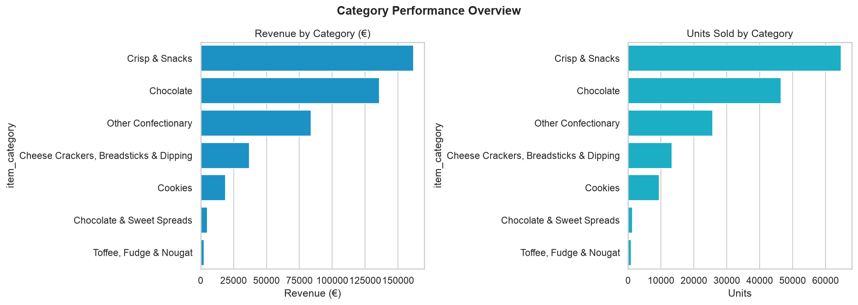
Category Performance Overview
• Crisp & Snacks leads on both revenue and units.
• Chocolate is the key growth driver in H2.
• Smaller categories remain opportunities but may need assortment/promotion tuning.

Slide 3
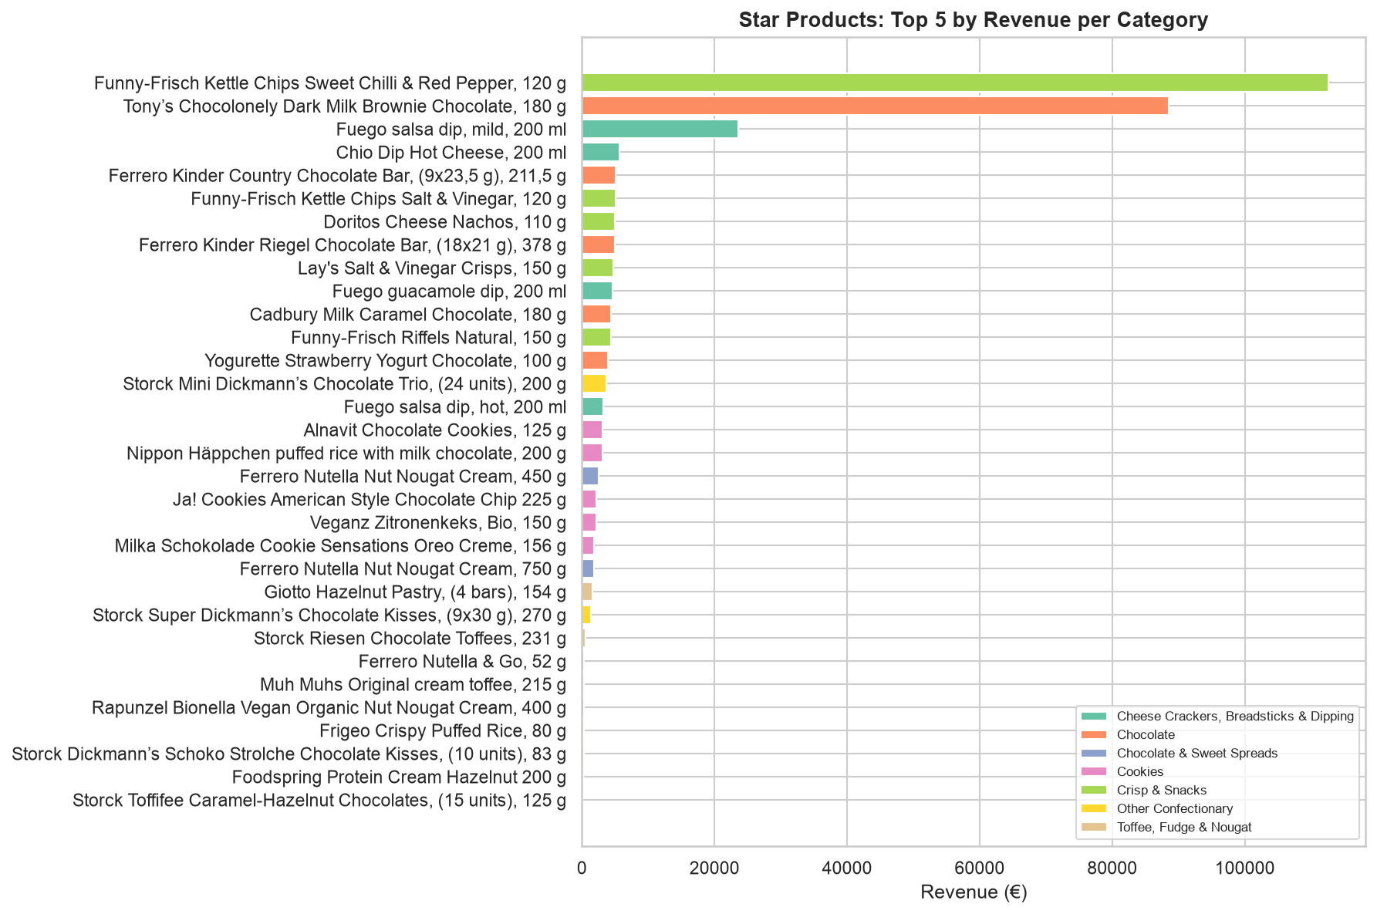
Star Products (by Revenue per Category)
• Within every category, a small set of items drives most revenue (Pareto-style concentration).
• Star products are the best candidates for targeted promotions and merchandising.

Slide 4
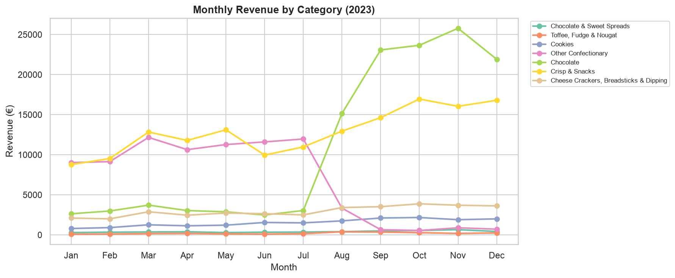
Seasonal Patterns: Monthly Revenue
• Chocolate shows pronounced growth from around August onwards.
• Several smaller confectionary categories shift sharply across mid-year (possible catalog/promo changes).

Slide 5
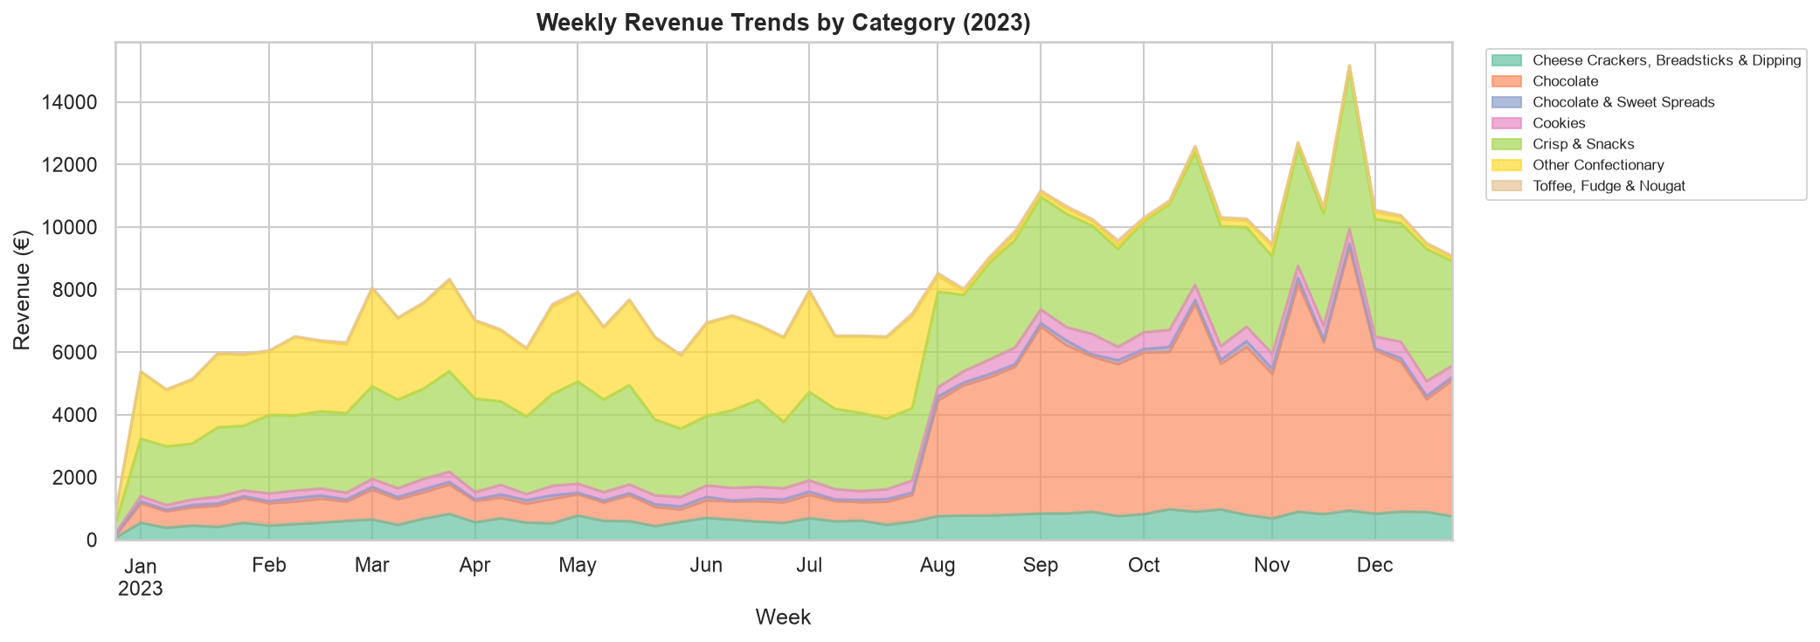
Underperforming Categories
• Underperformers identified by comparing H1 vs H2 2023 revenue by category.
• Worst performer: Cookies (66.4% H2 vs H1).
• Second worst: Toffee, Fudge & Nougat (109.2% H2 vs H1).
• Next step: verify whether the decline aligns with fewer promos, weaker star products, or assortment changes.

Slide 6
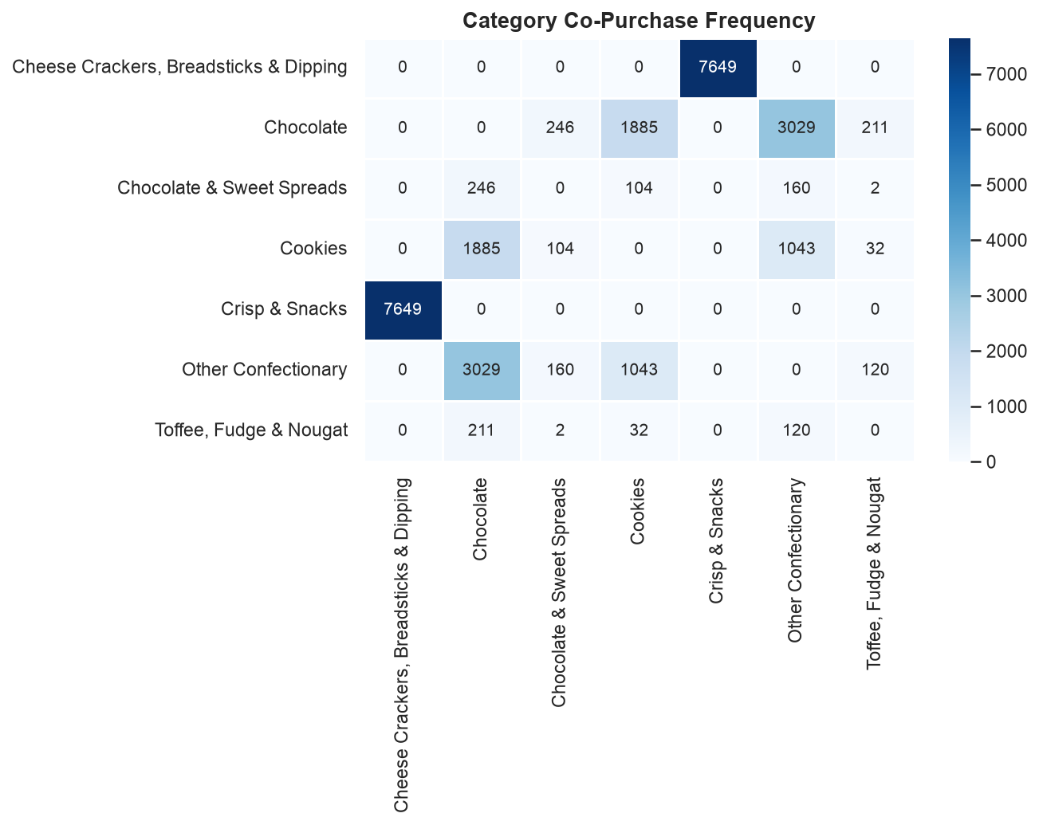
Market Basket: Category Co-Purchase
• Orders often include a single category, but meaningful cross-category co-purchases exist.
• Promoting the most common co-occurrence pairs could increase basket size.

Slide 7
Weekly Consumption Trends
• Weekly revenue curves highlight when each category ramps up or fades.
• Use these trends to time promotions and to anticipate shifts in demand.

Slide 8
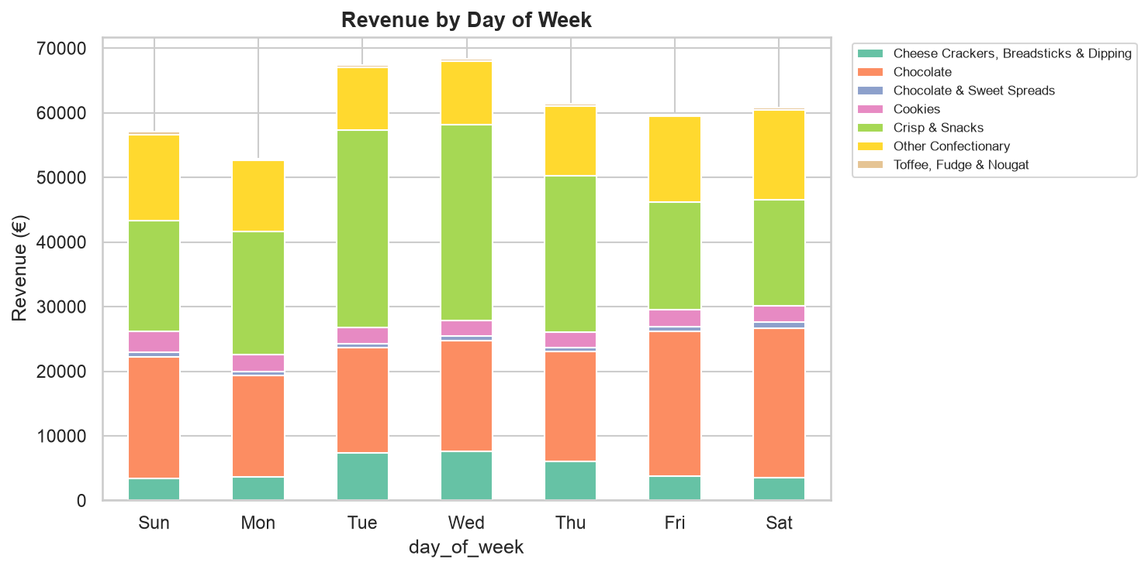
Consumption by Day of Week
• Day-of-week patterns are visible when revenue is stacked by category.
• This can support promo scheduling and courier capacity planning.

Slide 9
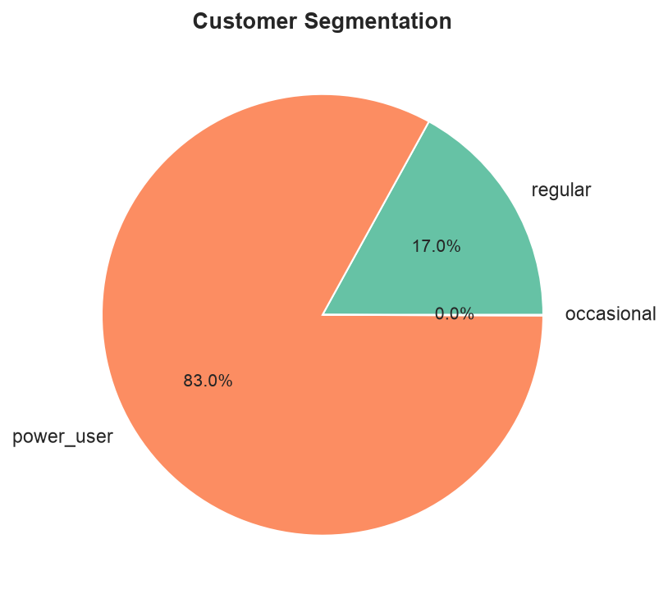
Customer Retention & Segmentation
• Segments based on purchase frequency show where revenue concentration lives.
• Retention is essential: repeat customers are disproportionately valuable.

Slide 10
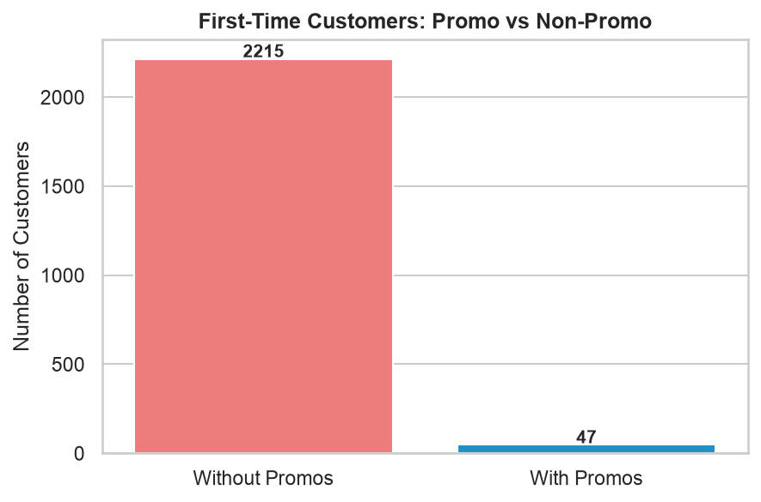
Promo Effectiveness: First-Time Customers
• Promos contribute first-time customers, but not all first-time orders include promo items.
• Key question: do promo-acquired customers buy only discounted items?

Slide 11
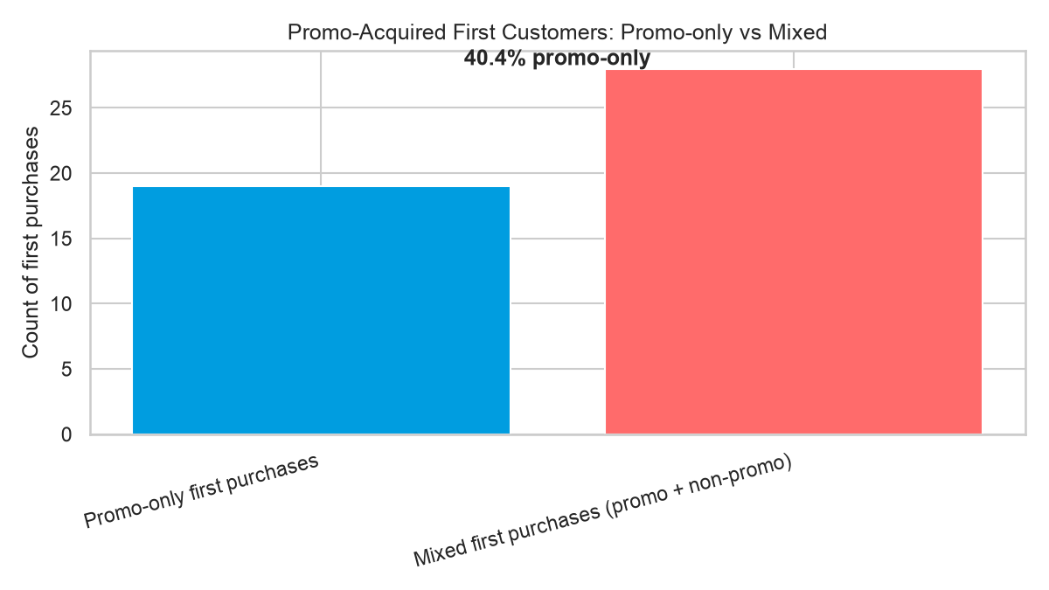
Do Promo First-Timers Buy Promo-Only?
• Among first purchases that included promos: 19/47 are promo-only.
• That equals 40.4% promo-only first purchases.
• Implication: promos likely attract customers who are price-sensitive; conversion to non-promo demand should be tracked.

Slide 12
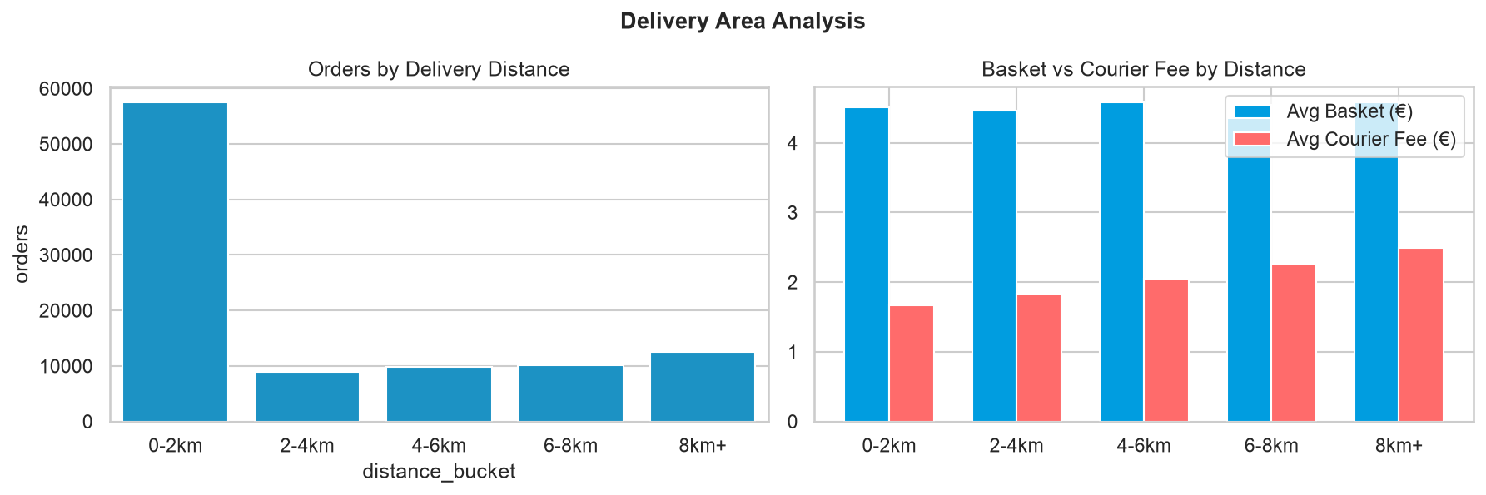
Delivery Area & Fee Structure
• Fee-to-basket ratio varies by distance bucket.
• Courier and Wolt service fees materially affect the customer spend experience for small baskets.

Slide 13
Appendix: Methodology & Data Notes
• Task 1: dbt + star schema + SCD Type 2 for item attributes at time of purchase.
• Task 2: metrics computed from mart tables; charts exported for business-friendly review.
• Data quality: duplicate item log rows were deduplicated; missing price values were imputed using last-known value.
• Deliverables: final datasets in `output/` + metrics CSVs used for charts.

